Slide 1
Draft Environmental Impact Statement Summary Presentation by the Louis Berger Group for Sterling Forest Resort
Public Hearing Pursuant to State Environmental Quality Review Act
Tuxedo, New York
December 4, 2014
Notes:
Good evening. My name is Larry Pesesky. I am a senior vice president with Louis Berger, one of the consulting firms retained by RW Orange County to prepare the draft environmental impact statement for its proposed Sterling Forest Resort. I will present a high-level, approximately 15-minute summary of of the DEIS content on behalf of RW Orange County.

Slide 2
Outline
Project Description
Project Purpose & Need
Project Alternatives
Environmental Impact & Mitigation Measures
Notes:
My presentation will cover these items. You are encouraged to view the document on the Town’s website – www.tuxedogov.org.

Slide 3
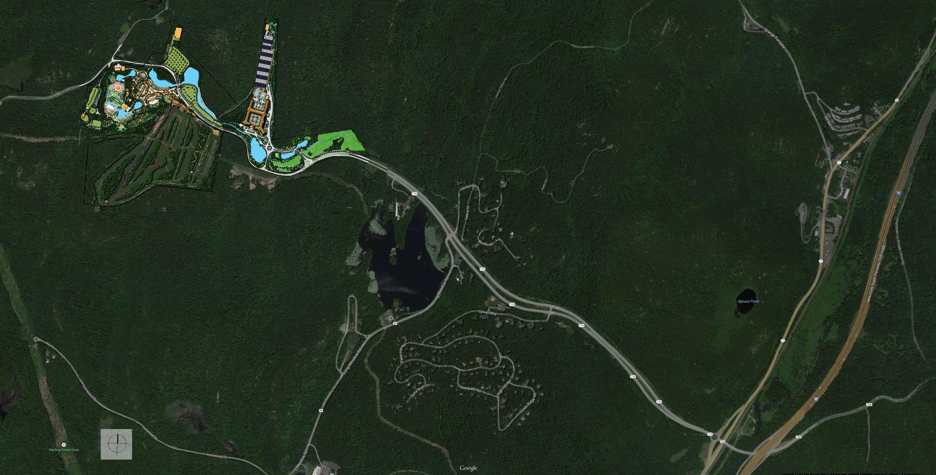
Project Site
Notes:
The project site consists of private property, known as “Ren-Faire Properties,” located in the northwest corner of the Town of Tuxedo, straddling NY State Route 17A. The parcels comprising the site total about 240 acres.

Slide 4
Project Description
Mix of resort uses (highlights)
1,000-room Resorts World Grand Hotel, six-to-seven stories tall, with casino (on abandoned landing strip)
World Fairgrounds (on existing New York Renaissance Faire site)
Ski Village (on existing Tuxedo Ridge Ski Center)
Re-established Sterling Gardens
Ancillary Uses
Dining and lodging-related commercial uses
Arboretum
2,500-seat amphitheater
Funicular inclined railway
Zip lines
Toboggan run
Snowboard pipes and rails
Indian Kill Riverfront Walk
Notes:
An “Integrated Resort” is proposed with these uses with multiple attractions for gaming and non-gaming guests across all age groups
The resort setting would make this a global destination for an estimated 7.8 million new visitors, that would be different from existing casinos in Northeast.

Slide 5
Proposed Access and Parking
Proposed new Interchange 15B on I-87/New York Thruway at Route 106
Subject to separate EIS under State Environmental Quality Review process
Chapter X of the Resort DEIS contains a cumulative impact assessment covering the combined impact of the Resort and Interchange
Total of 8,786 parking spaces (net increase of 5,786 spaces over existing)
Two grade-separated pedestrian bridges over Route 17A to connect the site’s activities

Slide 6
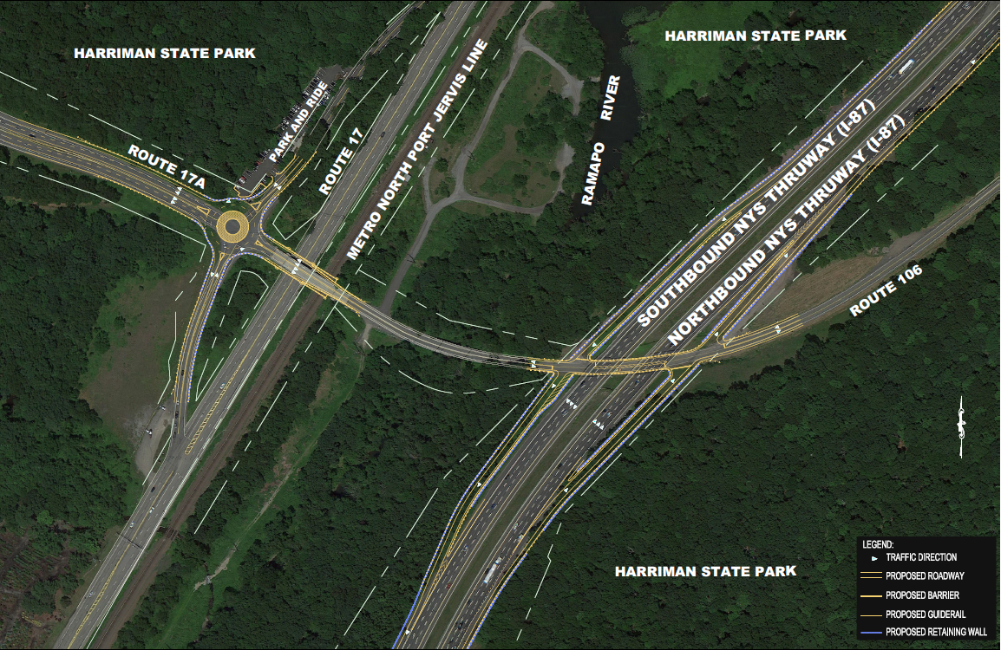
Proposed Interchange 15B

Slide 7
Project Purpose & Need
Meet the purpose and needs of the Upstate New York Gaming and Economic Development Act of 2013
Create jobs: the Project would create over 4,000 full and part-time jobs
Reduce unemployment in disadvantaged areas of the State: Hudson Valley has over 50,000 unemployed residents
Enhance the State’s tourism industry
Generate substantial revenue for public education and taxpayer relief
Be consistent with RW Orange County’s June 30 Application to the State in response to the Request for Applications (RFA) to Develop and Operate a Gaming Facility in New York State

Slide 8
Project Alternatives
No-Build Alternative
No changes from existing NY Renaissance Faire and Tuxedo Ridge Ski Center uses
Does not meet the Purpose and Need
As-of-Right Alternative
Redevelopment to the maximum allowed under existing zoning: 49 single-family residences on 177.2 acres
Does not meet the Purpose and Need
Alternative Architectural Building Design
Height of spires on hotel reduced from over 200 feet to 172 feet, consistent with the Scoping Document
Otherwise, identical to the Proposed Project with increased mitigation

Slide 9
Land Use, Zoning & Public Policy
No-Build Alternative
Maintains existing land uses; consistent with zoning
Does not advance economic development goals of the Town Comp Plan
No anticipated impact on community character
As-of-Right Alternative
Replaces existing land uses with residential; consistent with zoning
Does not advance economic development goals of the Town Comp Plan
No anticipated impact on community character
Proposed Project/Architectural Design Alternative
Adds fuller use of the site; maintains existing land uses
Consistent with Gaming Overlay Zoning District & Town Comprehensive Plan
Potential impacts on community character mitigated through traffic mitigation and measures to minimize visibility

Slide 10
Geology, Soils & Topography
No-Build Alternative
No increase in development “footprint” or impact from site development
Would not resolve soil erosion from existing site uses
As-of-Right Alternative
Site development footprint of ~34 acres
Less excavation than Proposed Project
Proposed Project/Architectural Design Alternative
Additional development footprint of ~19 acres over ~27 acres of existing development, with limited excavation
Mitigation through adherence to soil erosion and sediment control plan

Slide 11
Groundwater Resources
No-Build Alternative
Lack of stormwater management continues to reduce infiltration from pre-development levels
As-of-Right Alternative
Depending on the residential design, potential impact could be similar to Proposed Project
Proposed Project/Architectural Design Alternative
Potential construction period impact from subsurface construction and dewatering; potential permanent impact from increase in impervious surfaces and reduction in infiltration to groundwater
Mitigated through such mitigation measures minimizing construction limits and avoiding introduction of contaminants to groundwater during construction, and infiltration from water recycled for irrigation

Slide 12
Wetlands & Surface Waters
No-Build Alternative
Lack of stormwater management continues to have soil erosion and sedimentation impact on wetlands and open waters
As-of-Right Alternative
Potential fill/disturbance of 0.12 acre of an isolated wetland
Proposed Project/Architectural Design Alternative
Potential fill/disturbance of 3.6 acres of wetlands
Design changed to reduce level of wetland impact
Mitigation, including restoration of 6.1 acres of previously disturbed wetlands, would produce a net increase in the acreage of on-site wetlands

Slide 13
Vegetation & Wildlife
No-Build Alternative
No change from existing impact, including no vegetative management to control invasive species
As-of-Right Alternative
Potential impact on 25.15 acres of natural and vegetative communities; 7.03 acres of tree removal
Proposed Project/Architectural Design Alternative
Potential impact on natural and vegetative communities
Mitigation through preservation of undisturbed areas and vegetation management

Slide 14
Stormwater Management
No-Build Alternative
Existing 26.81 acres of impervious surfaces would remain without stormwater runoff management and treatment
As-of-Right Alternative
15.11 acres of impervious surfaces with standard storwater management and treatment
Proposed Project/Architectural Design Alternative
Increase of 31.96 acres of impervious surface cover over existing
Potential impacts minimized through stormwater retention/filtration, green roofs, and 13.7 acres of permeable pavement for surface parking

Slide 15
Water Supply
No-Build Alternative
No change from existing demand
As-of-Right Alternative
Demand expected to be well within United Water service capacity and substantially less than Proposed Project
Proposed Project/Architectural Design Alternative
Water demand of less than half of the Indian Kill reservoir safe yield of 600,000
Net effect on Indian Kill Reservoir inflows of ˂1% because of water recycling for irrigation and reintroduction to Reservoir catchment

Slide 16
Wastewater
No-Build Alternative
No change from existing impact from outmoded treatment facility
As-of-Right Alternative
Assumed negligible impact and use of existing wastewater treatment plant
Proposed Project/Architectural Design Alternative
Negligible impact as wastewater reclamation facility would treat sanitary flows to better than Class A water standards

Slide 17
Energy Use & Infrastructure Capacity
No-Build Alternative
No change; site remains served by electricity only
As-of-Right Alternative
Negligible impact from electric consumption estimated between 7,236 and 9,600 kWh per month; assumed site remains served by electricity only
Proposed Project/Architectural Design Alternative
Negligible impact relative to existing electricity and natural gas supplies
Incorporates renewable energy through solar to meet at least 10% of development needs

Slide 18
Visual Character & Aesthetic Resources
No-Build Alternative
Expected continued local adverse impact due to degraded Ren Faire structures
As-of-Right Alternative
Expected improved visual and aesthetic character over No-Build Alternative; less visual impact than other Build alternatives due to lower building heights
Architectural Design Alternative
Design reduces potential impact by using colors and materials compatible with the surrounding landscape and environment
Potentially significant visual impacts from Katrina Court and Hogback Mountain Trail
Proposed Project
Design reduces potential impact by using colors and materials compatible with the surrounding landscape and environment
Potential visual impacts from Katrina Court, Clinton Woods, Allis Trail, and Hogback Mountain Trail

Slide 19
Traffic, Transportation & Parking
No-Build Alternative
Ren Faire traffic impacts would continue including uncontroled pedestrian crossings of Route 17A, parking on the shoulder of Route 17A, and some intersections with unacceptable levels-of-service
Continued traffic congestion on Route 17 through Town
As-of-Right Alternative
Minimal traffic impacts; some intersections with unacceptable levels-of-service
Continued traffic congestion on Route 17 through Town
Proposed Project/Architectural Design Alternative
Substantial increase in volume and continuousness of trips generated by site
Measures to minimize traffic impact include: construct Interchange 15B; construct roundabout at Routes 17/17A intersection; roundabout, Route 17A widening, and second entrance intersection at the site; adequate on-site parking; and two pedestrian bridges to connect the site portions
Traffic relief on Route 17 through Town

Slide 20
Noise
No-Build Alternative
No change from existing
As-of-Right Alternative
Minimal (˂3dB) impact from trips generated by residences, primarily during commuter peak periods
No major stationary noise sources
Proposed Project/Architectural Design Alternative
36 total residences in Clinton Woods and laurel Ridge would be impacted by increased nighttime traffic on Route 17A; noise mitigated through building/window insulation and other treatments
Residences and parkland in the Project vicinity would experience noise impacts, primarily in late night hours, with a perceived relative change of up to a doubling of noise levels but at relatively low absolute levels consistent with a rural area; mitigation includes restriction on end time of amphitheater events, placement of snow guns away from residences at night, and shielding of HVAC equipment
Existing sounds levels from I-87 in the East Village will increase, although imperceptibly, due to opening of Interchange 15B; previous studies conducted by the NYS Thruway Authority have identified an existing impact (without 15B), and the impact and mitigation will appropriately be assessed during the Interchange 15B EIS, with the traffic input to the analysis to include anticipated Resort traffic

Slide 21
Air Quality
No-Build Alternative
No change from existing impact
As-of-Right Alternative
No exceedance of air quality standards from traffic-related or residential heating systems emissions
Proposed Project/Architectural Design Alternative
Increased emissions from site uses but within air quality standards
No potential for adverse impacts from off-site intersections and roadway segments affected by Project-generated traffic
Mitigation of on-site sources include high-efficiency low-NOx boilers and CNG-fueled shuttle buses

Slide 22
Community Services & Fiscal Impacts
No-Build Alternative
No change from existing demand for services, expenditures, or revenues
As-of-Right Alternative
Minimal adverse impact from increased demand for police, fire, emergency, and road maintenance services and corresponding expenditures
Proposed Project/Architectural Design Alternative
Potential impact from increase in demand for police, Town court, fire (negative net fiscal impact for Tuxedo Joint Fire District), emergency, and road maintenance services and corresponding revenues; mitigation measures to be finalized during FEIS preparation
Positive net fiscal impact for the Town of Tuxedo and Orange County

Slide 23
Cultural Resources
No-Build Alternative
No change in existing minimal, indirect impacts on archaeological sites
As-of-Right Alternative
Potential for direct adverse impact to one archaeological site
Proposed Project/Architectural Design Alternative
Potential impact to any archaeological sites with mitigation (data recovery) to be coordinated with government and Tribal authorities

Slide 24
Solid Waste & Hazardous Materials
No-Build Alternative
No change in solid waste generation from the site
As-of-Right Alternative
Relatively low solid waste generation from residences
Proposed Project/Architectural Design Alternative
Potential impact from construction solid waste per month and approximately four tons of solid waste generated by daily operations
Impacts to be mitigated through program of sustainable purchasing and recycling to reduce waste

Slide 25
Socioeconomics
No-Build Alternative
No change in employment and regional economic effect of existing site uses regional
As-of-Right Alternative
Potential for adverse effect on the local economy from the displacement of the Renaissance Faire to a location likely outside of Tuxedo
Proposed Project/Architectural Design Alternative
Project would have a substantial regional employment effect due to the creation of over 4,000 permanent jobs
Project would have a substantial beneficial effect on the local and regional economy from increased disposable income from above-market wages and benefits offered to employees and operational expenditures
Most jobs would be filled by existing residents of the region creating negligible demand for new housing
Existing business operations on the site would be enhanced and revitalized with a greater offering of entertainment options

Slide 26
THANK YOU!

